Slide 1

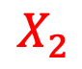
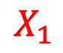

$$Δ$$
$$X_{2}$$
$$X_{1}$$
2H
L
$$Δ$$
2L
Notes:
Figure 1
Schematic of plane stress pure shear test geometry with height of $2h$ where crack length is half the length of the domain, $2L$. Displacement is denoted by $\Delta$.

Slide 2
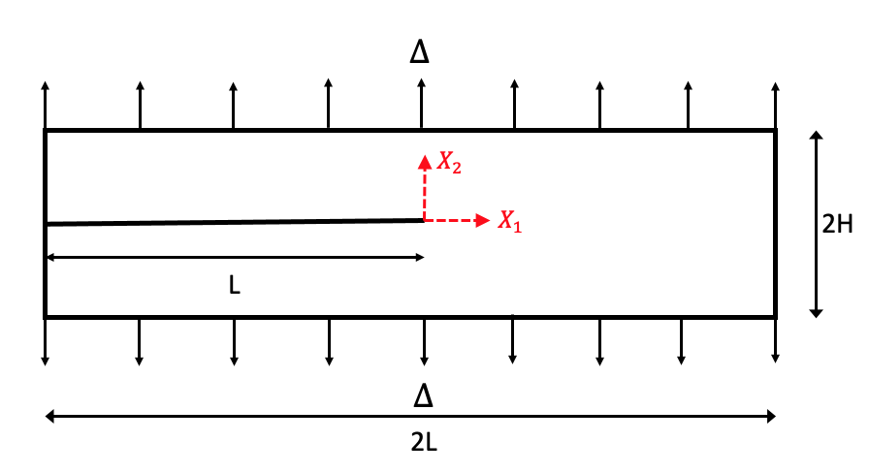
Half the width of the PF
a)
b)
Notes:
b) Comparison of the Mode I deformation field $y_1$ and $y_2$ simulation results with the range of the analytical solution. Phase-field results include diffused results (red) where the phase-field is diffused over 20 elements and discrete crack geometry (black).

Slide 3
a)
b)

Slide 4
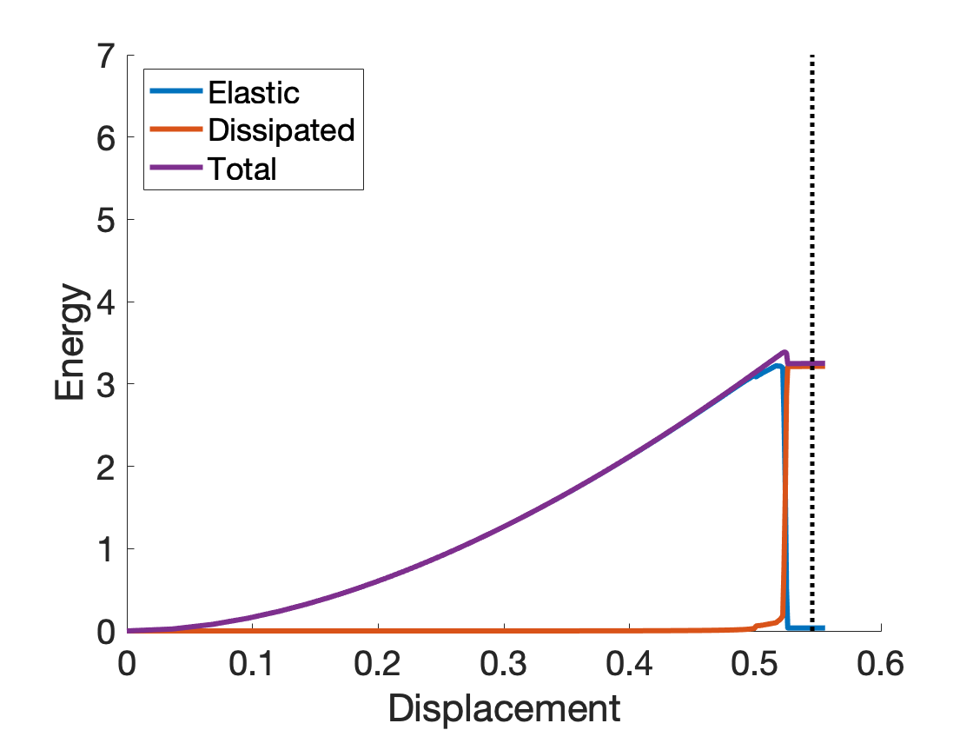
a)
b)

Slide 5

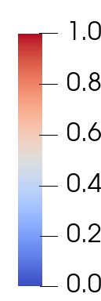
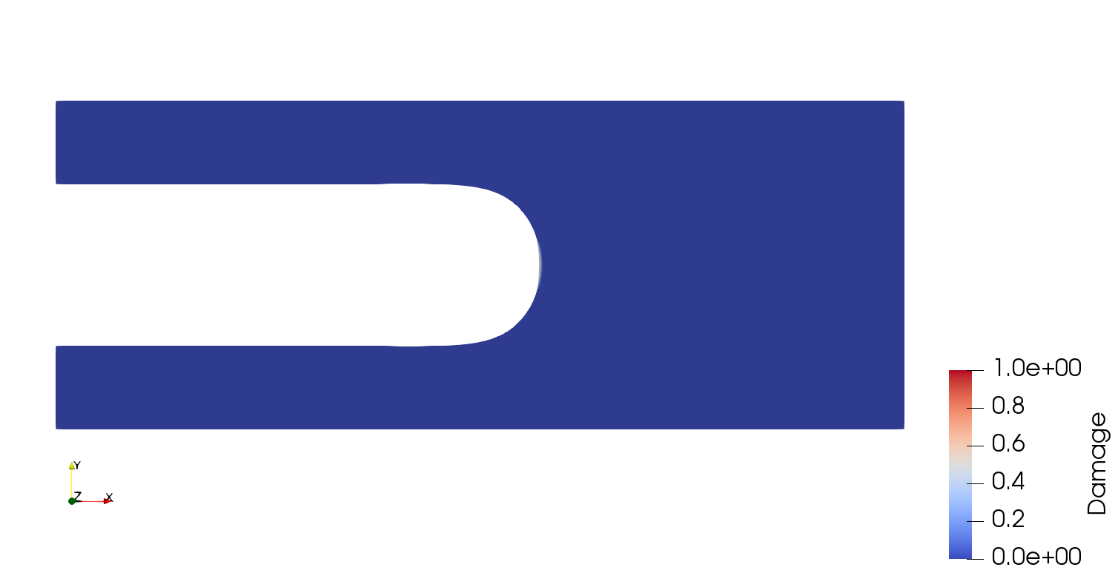
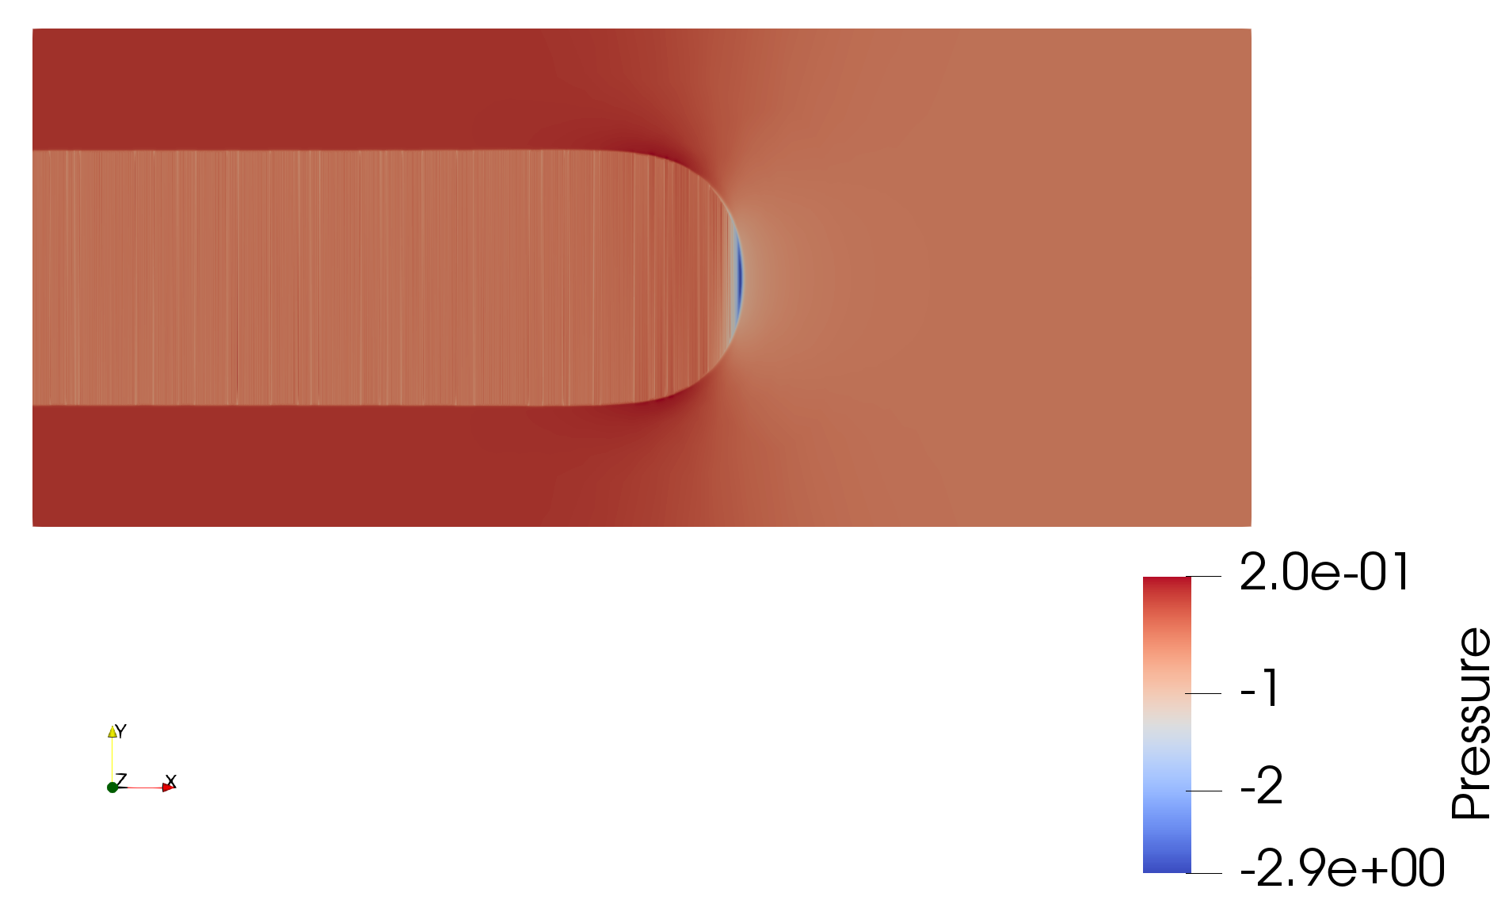
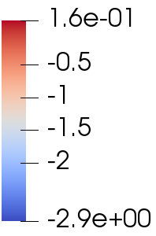
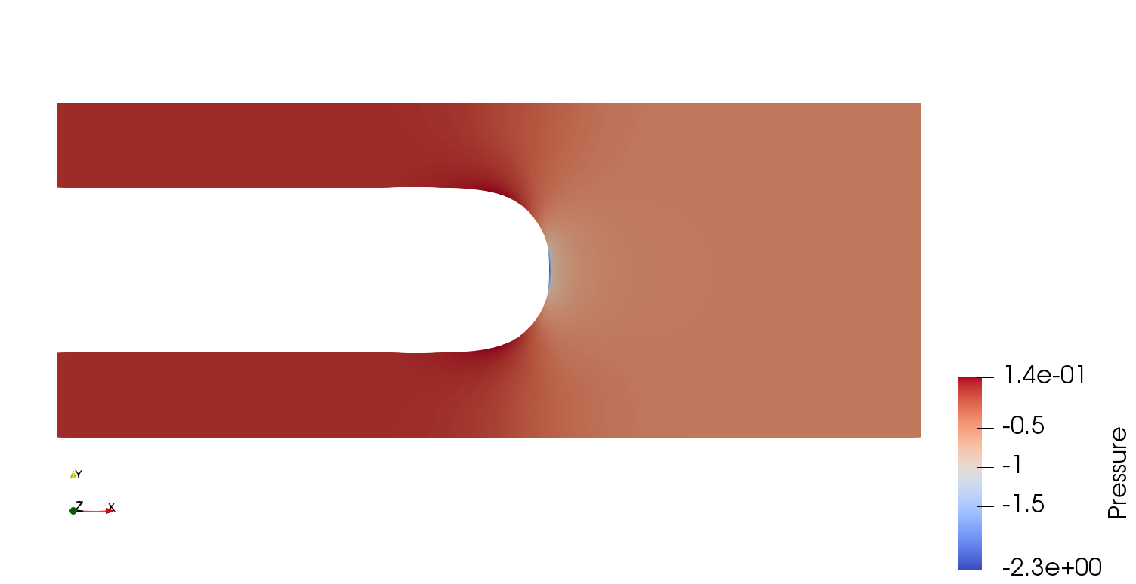
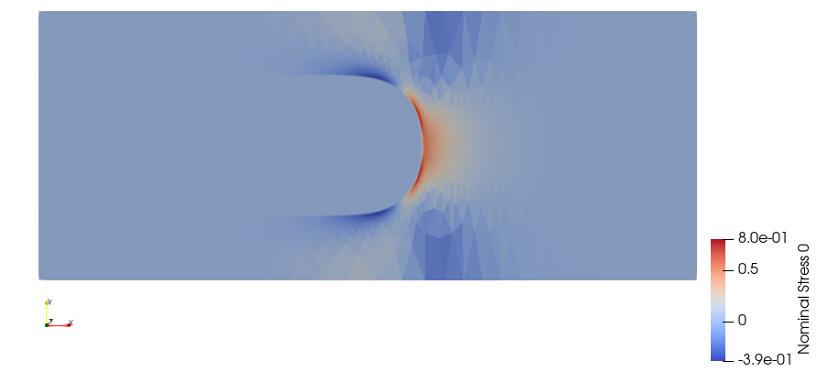
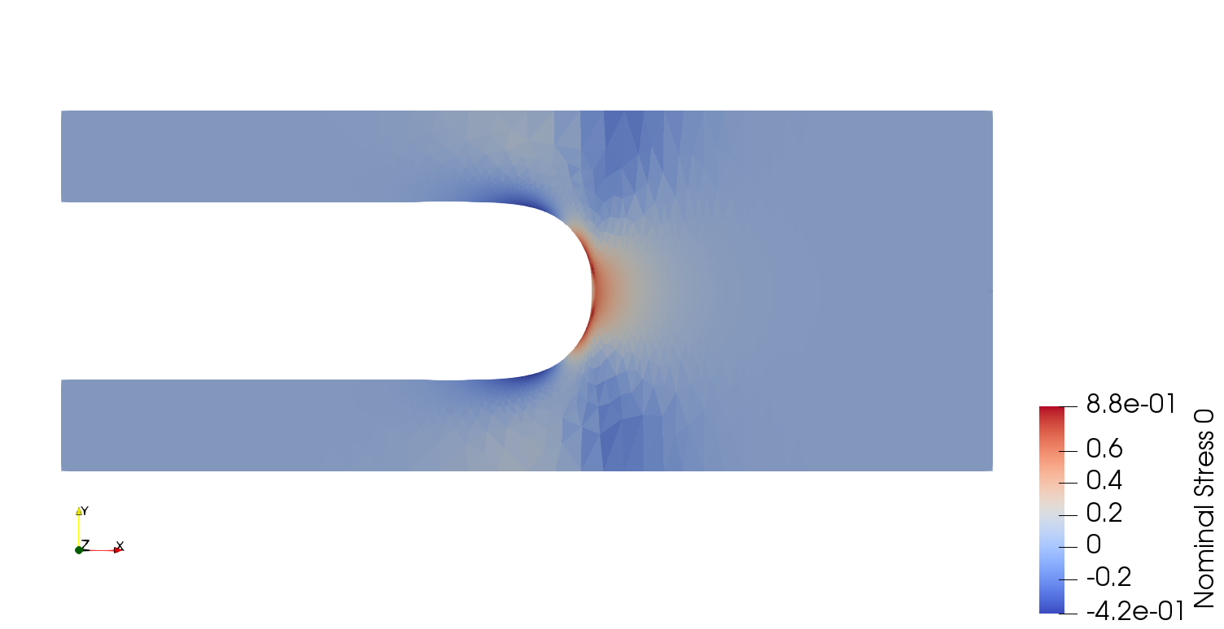
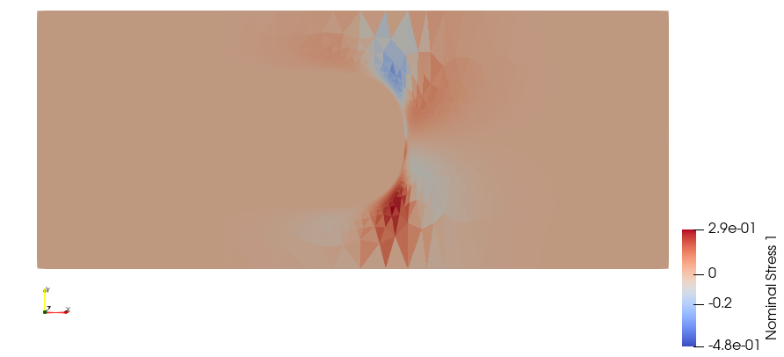
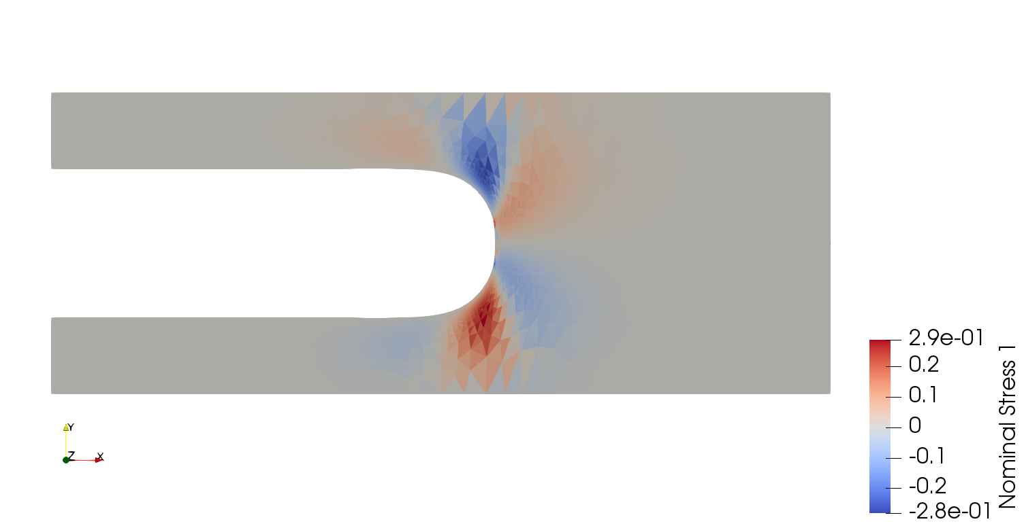
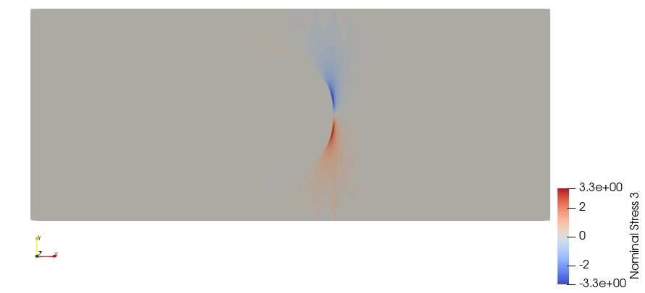
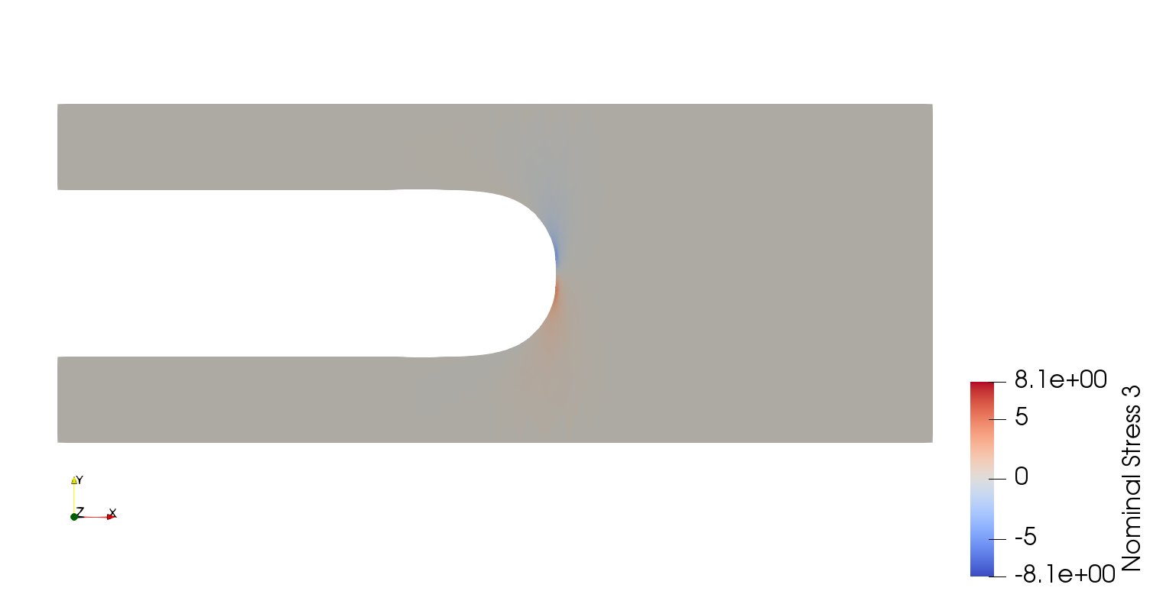
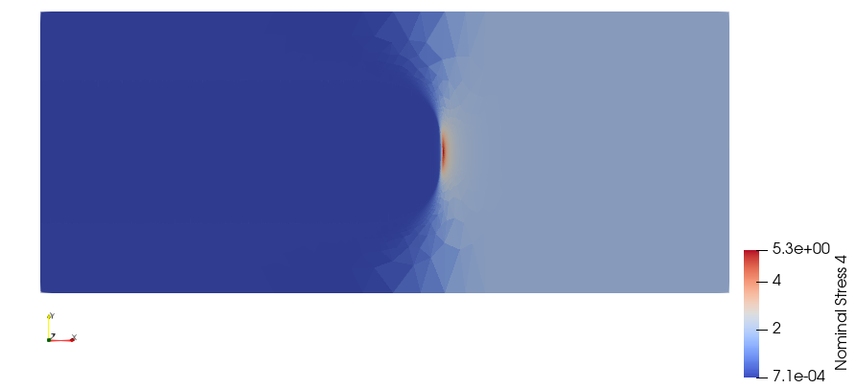
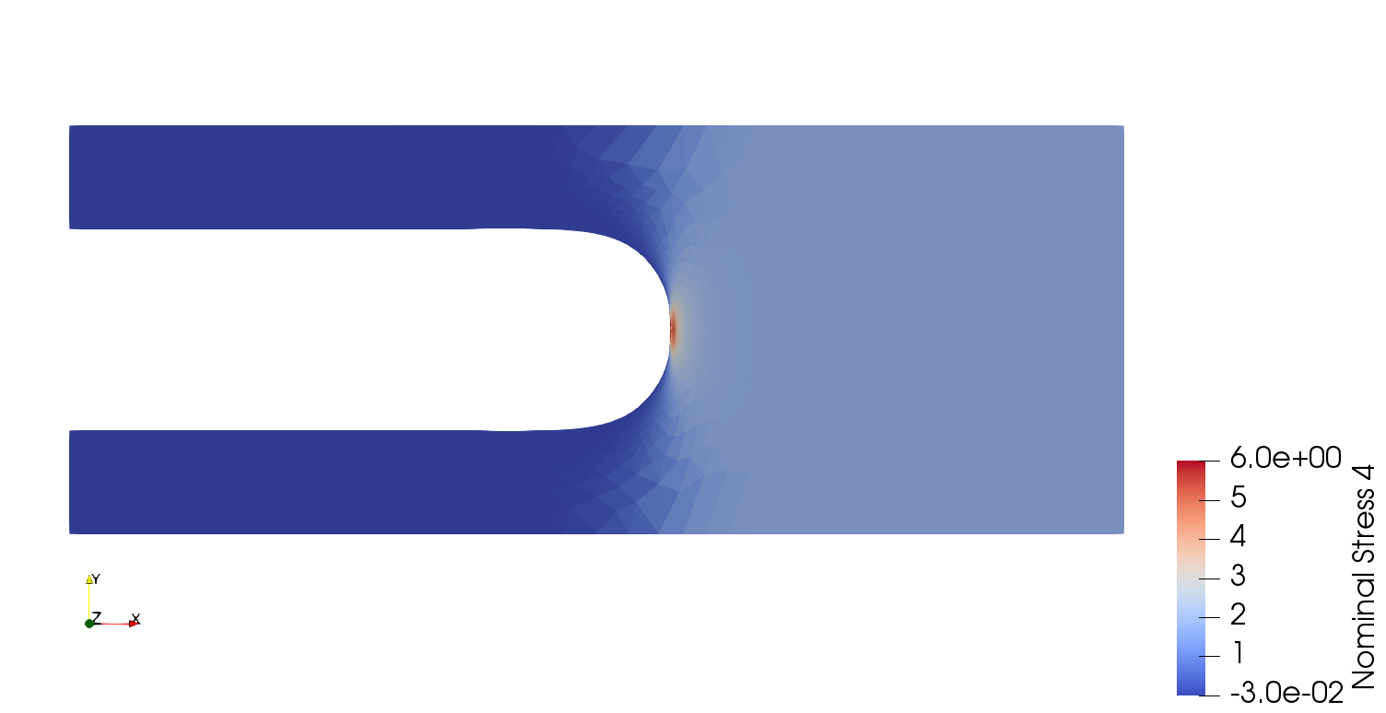
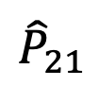
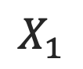
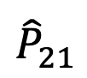
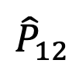
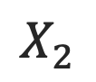
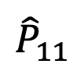
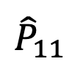
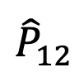
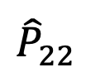
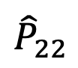
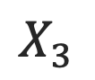
Damage
Damage
a)
2.0e-01
Pressure
Pressure
b)
$${\hat{P}}_{11}$$
$${\hat{P}}_{11}$$
$${\hat{P}}_{12}$$
$${\hat{P}}_{12}$$
$${\hat{P}}_{21}$$
$${\hat{P}}_{21}$$
$${\hat{P}}_{22}$$
$${\hat{P}}_{22}$$
$$X_{2}$$
c)
$$X_{3}$$
$$X_{1}$$

Slide 6
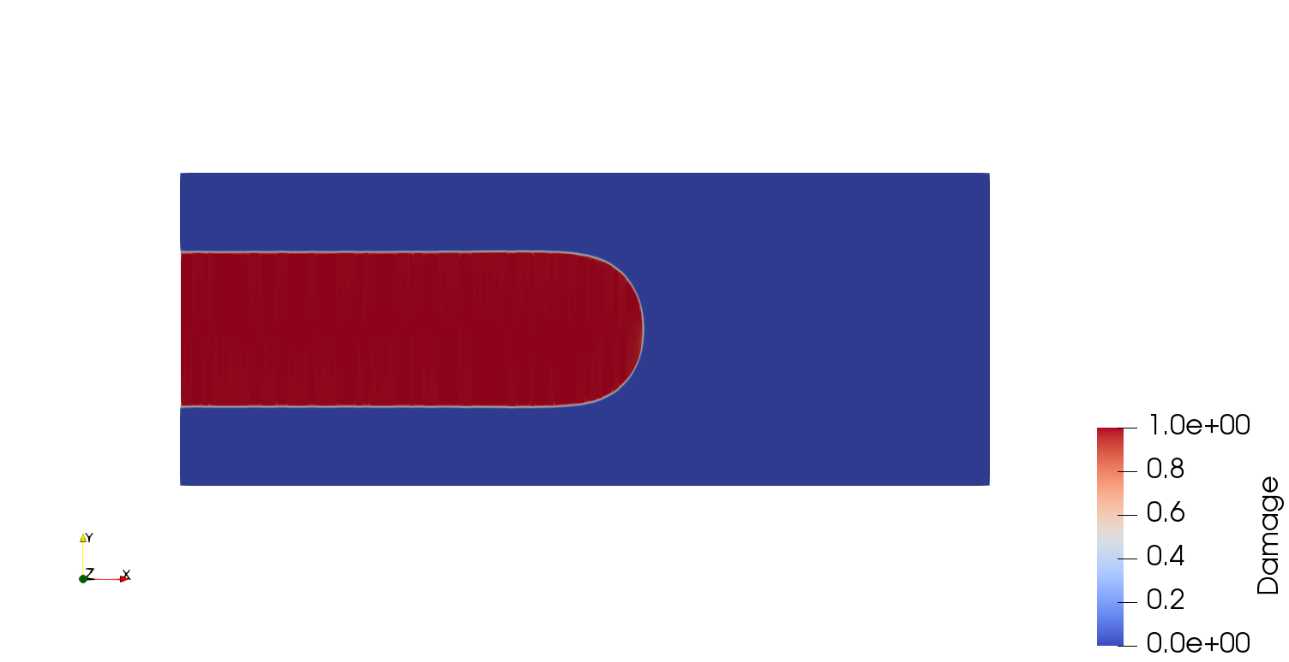
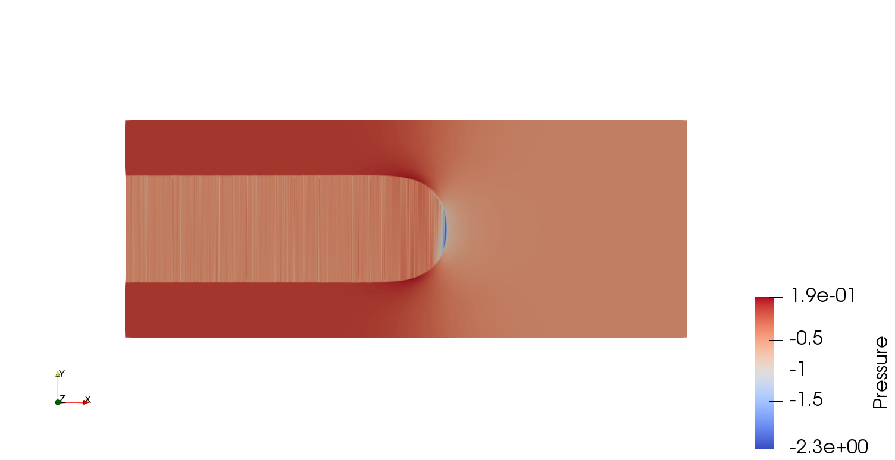
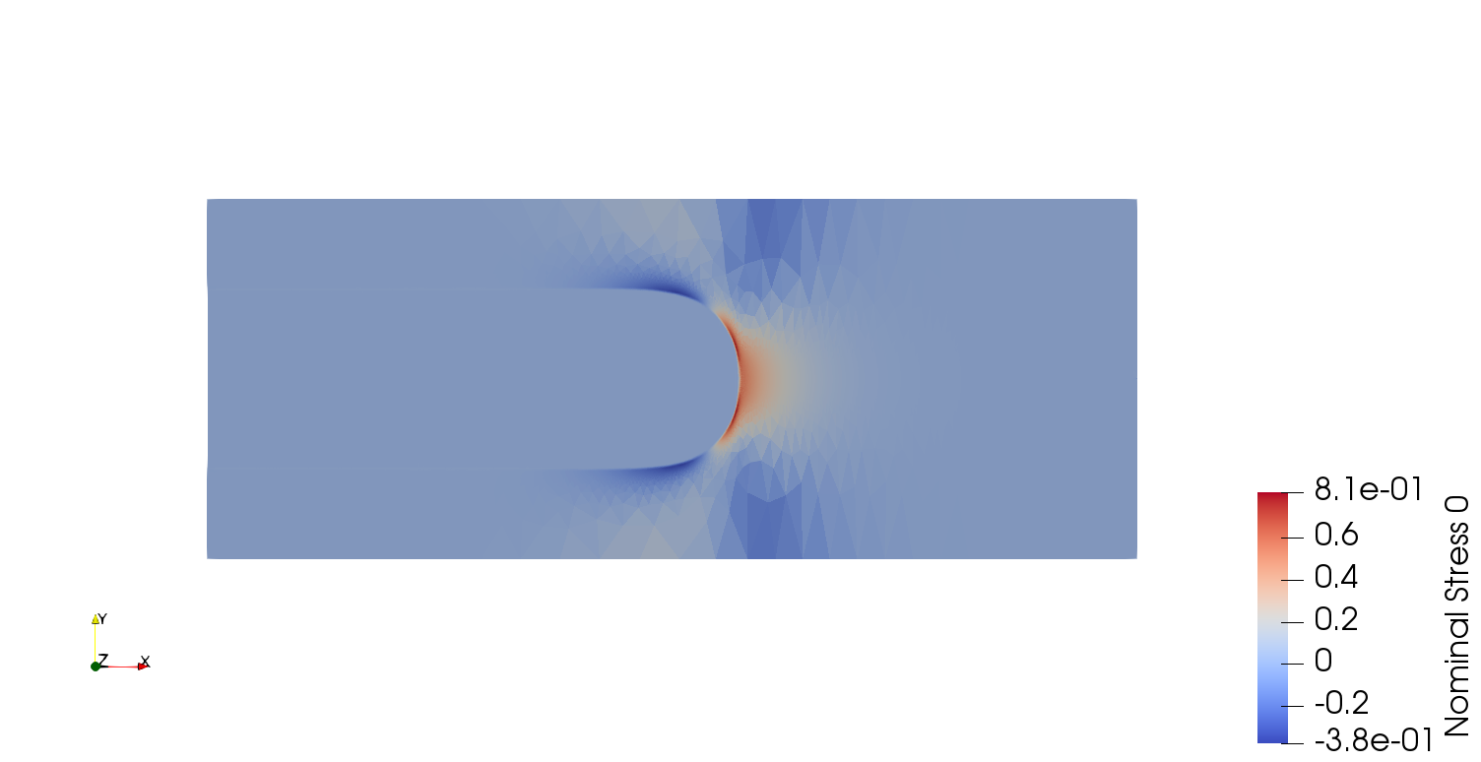
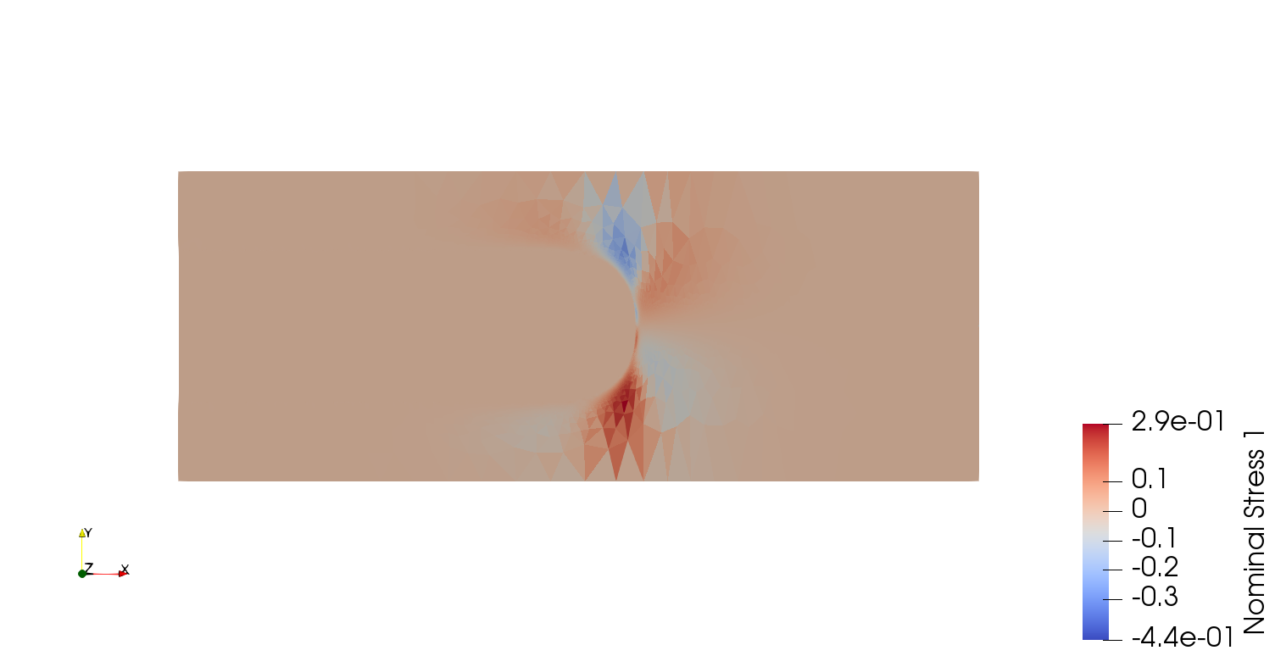
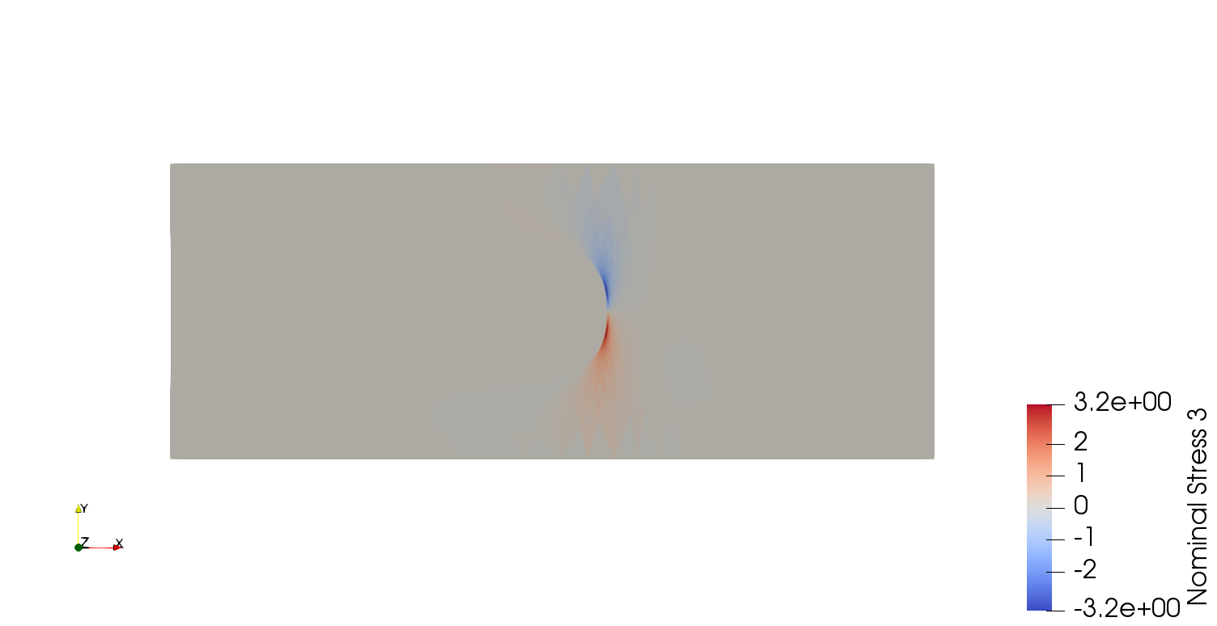
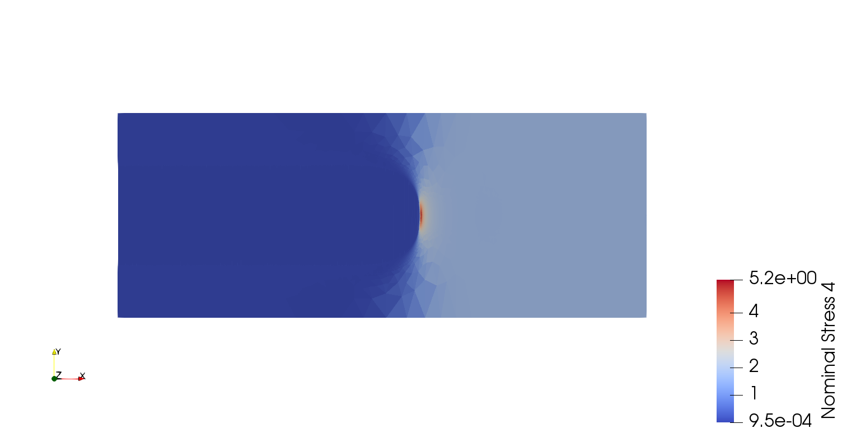
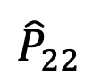
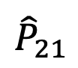
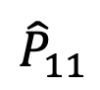
Damage
Damage
a)
Pressure
Pressure
b)
$${\hat{P}}_{11}$$
$${\hat{P}}_{11}$$
$${\hat{P}}_{12}$$
$${\hat{P}}_{12}$$
$${\hat{P}}_{21}$$
$${\hat{P}}_{21}$$
$${\hat{P}}_{22}$$
$${\hat{P}}_{22}$$
$$X_{2}$$
c)
$$X_{3}$$
$$X_{1}$$
Notes:
Equivalent stretches of 0.482

Slide 7
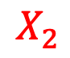
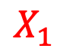
R
$$X_{2}$$
2H₀
$$X_{1}$$
2H
c
2L

Slide 8
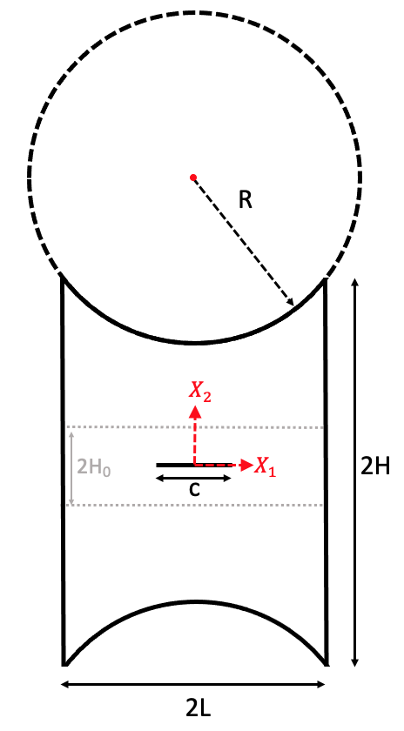
a)
b)
Notes:
Figure 4:
a) Simulation geometry to study stable crack propagation in 2D motivated by trapezoidal simulations \cite{} where length and height are defined as $2L$ and $2h$ respectively. A region of $2h_0$ allows for uniform refinement for the phase-field method. A circle with radius $r$ is used to define the top and bottom surface and b) the evolution of the energies as the displacement on the top surface is increased and the bottom surface is held fixed.

Slide 9
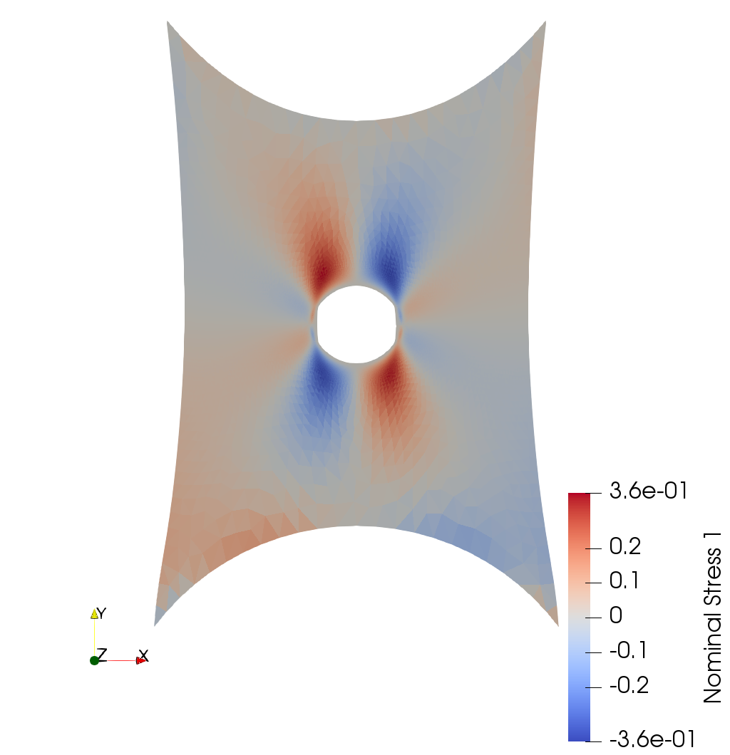
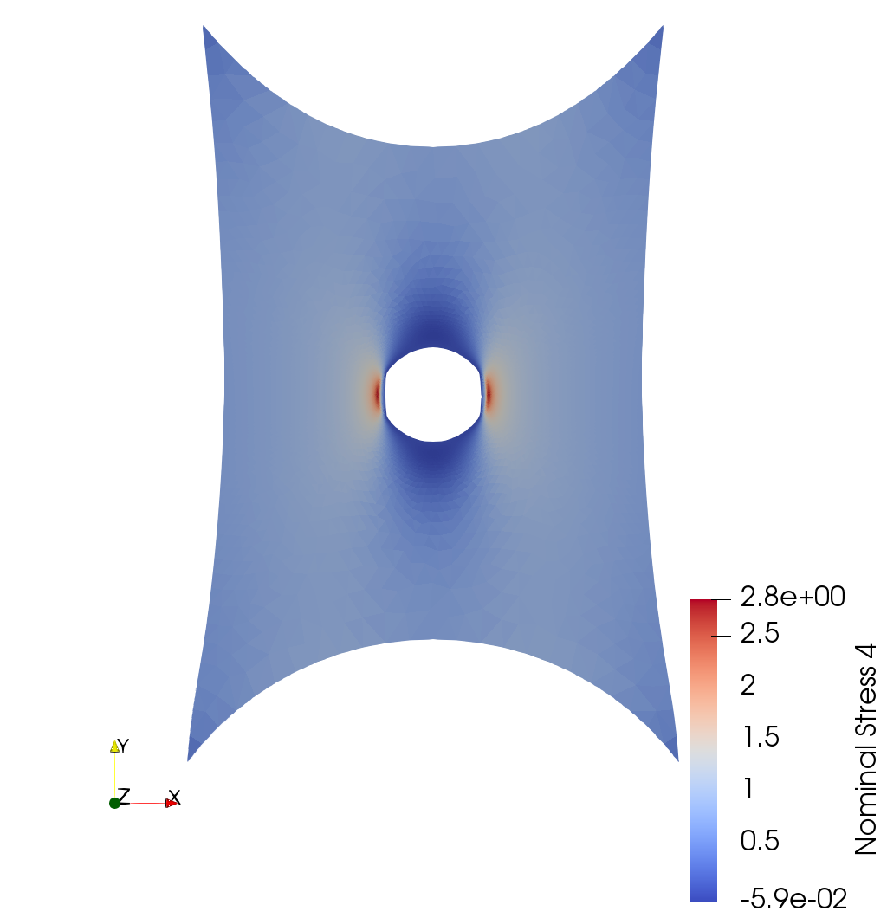
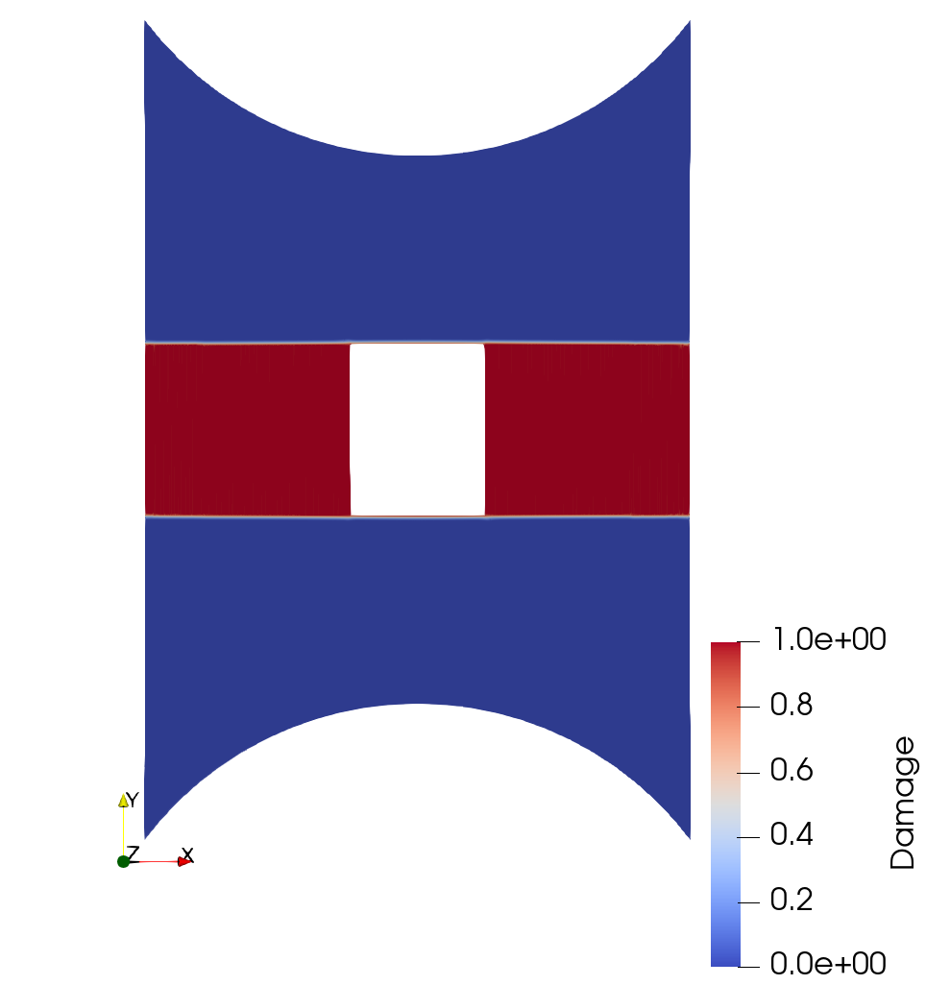
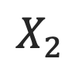
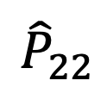
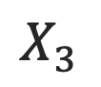
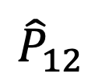
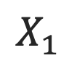
$${\hat{P}}_{12}$$
$${\hat{P}}_{22}$$
$$X_{2}$$
a)
$$X_{3}$$
$$X_{1}$$
Damage
b)
Ⅰ
Ⅱ
Ⅲ
Ⅳ
Ⅴ
Notes:
Figure 5: Original

Slide 10
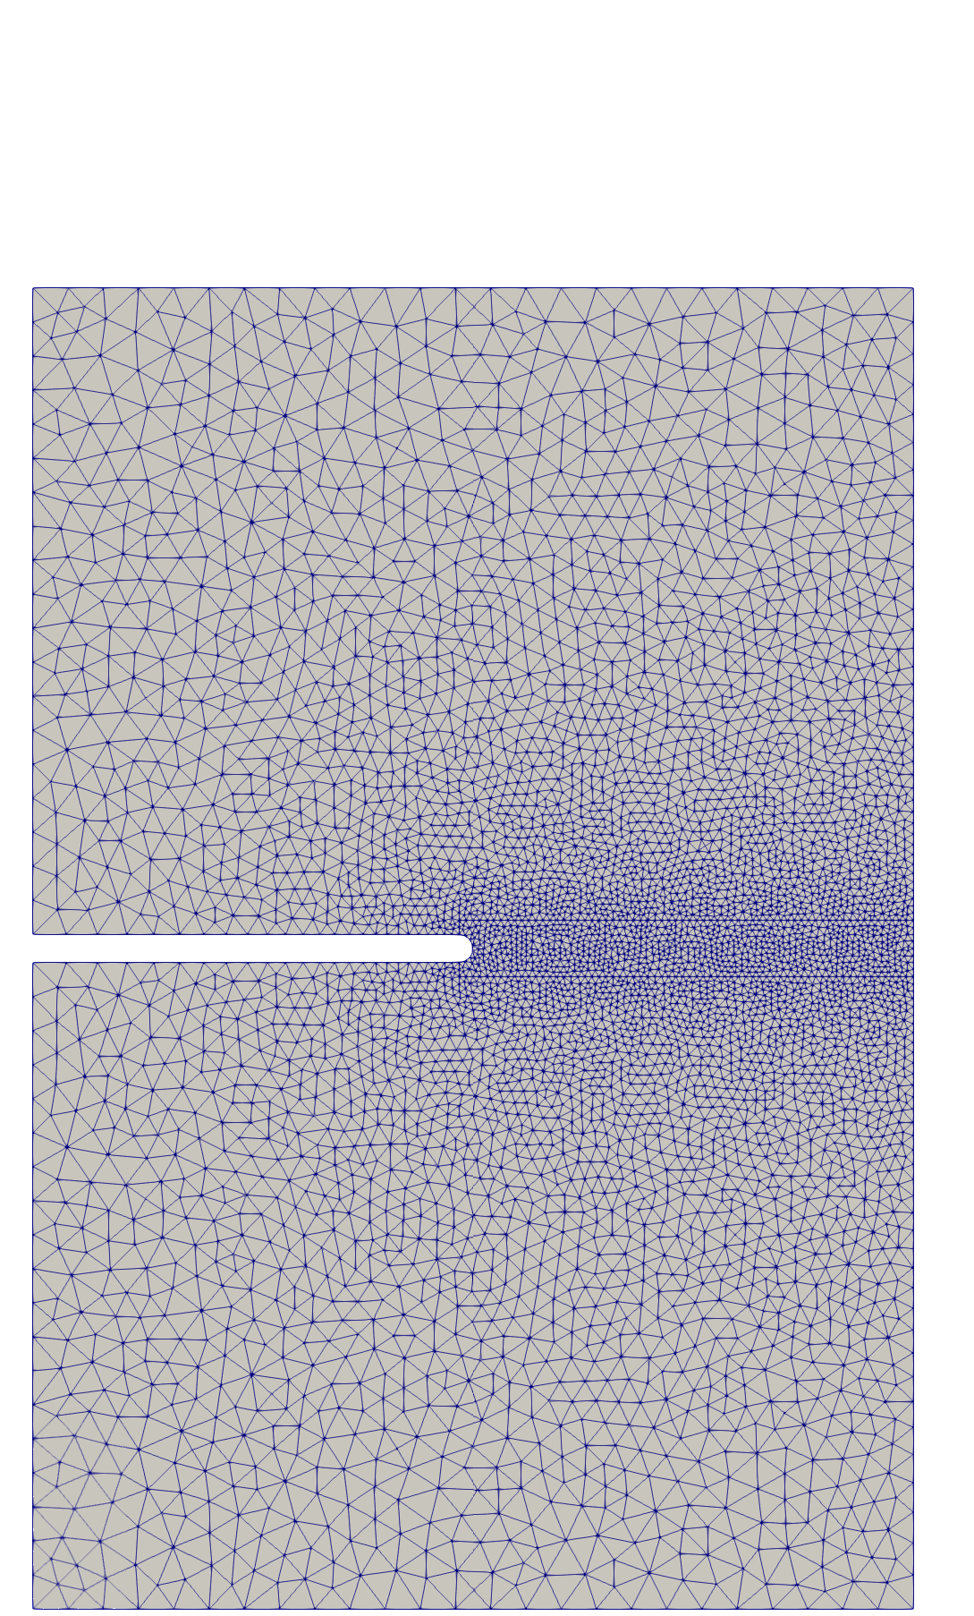
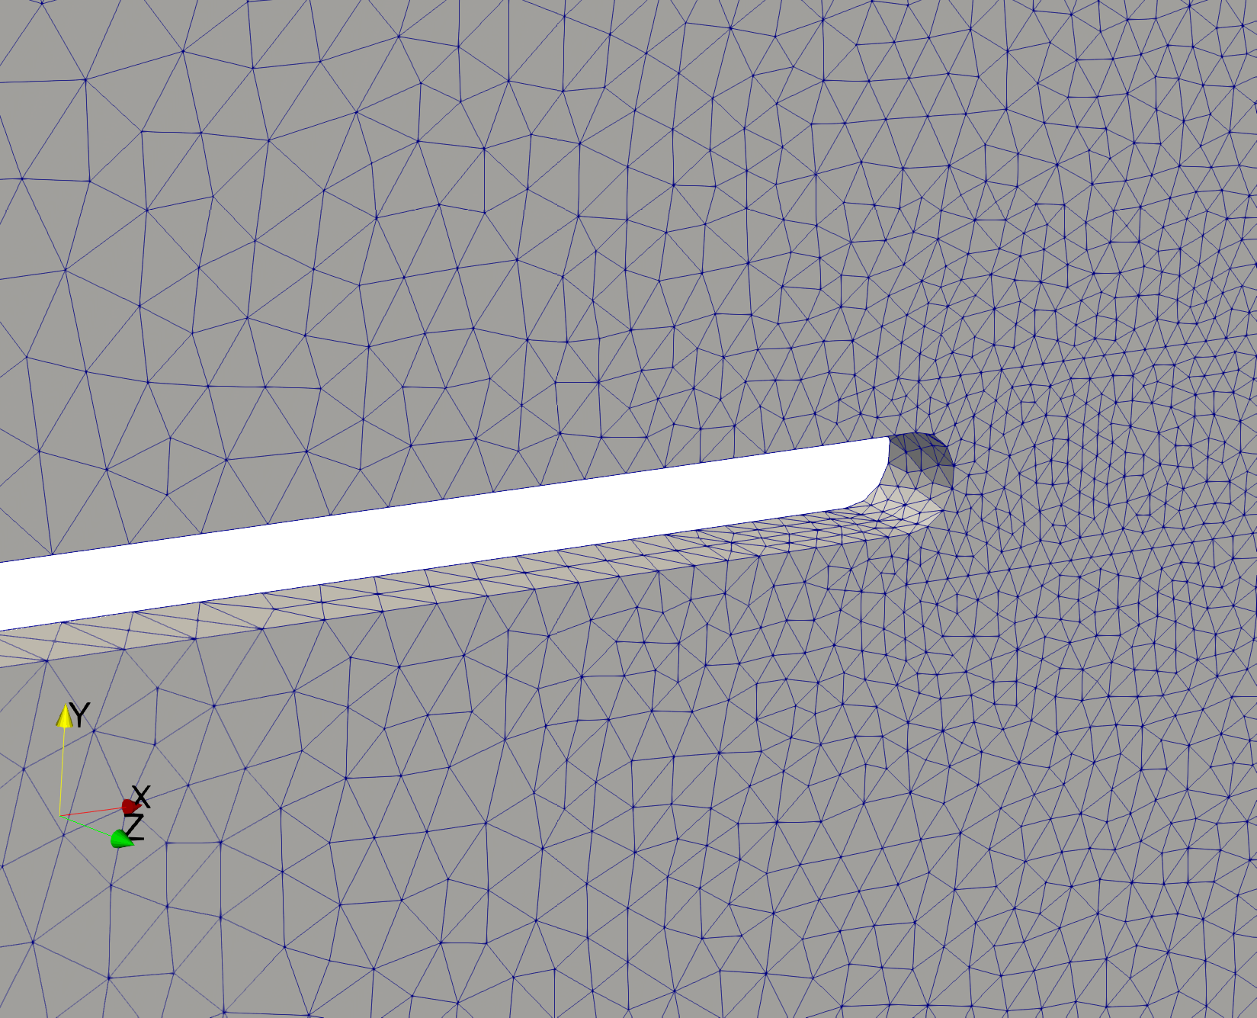







$$X_{2}$$
L
H
$$X_{3}$$
$${2H}_{0}$$
$$X_{1}$$
$$X_{2}$$
$$X_{1}$$
$$X_{3}$$
Notes:
Figure 6
Geometry for 3D notched sample where height is $2H = 1.5$, length is $2L = 1.0$, and thickness is $2T= 0.032$. The element size is $h_{size} = 0.008$ close to the crack and $0.04$ at the boundaries.

Slide 11









$$X_{2}$$
Damage
$$X_{3}$$
$$X_{1}$$
Ⅰ
Ⅱ
Ⅲ
Ⅳ
Ⅴ
Ⅵ
Notes:
Figure 7: Damage evolution for 3D notched sample where the fracture energy, $G_c = 1$, shear modulus, $\mu = 1$, and bulk modulus $\kappa = 200$ are specified and the sample is loaded until the crack propagates through the sample fully.
0, 50, 150, 250, 274, 275

Slide 12











$$J=detF$$
$$X_{2}$$
$$X_{3}$$
$$X_{1}$$
$X_{2}$=0.12
a)
$X_{2}$=0.02
b)
Notes:
Figure 8: Evolution of the third invariant of the deformation tensor, $J = \det \mathbf{F}$
0, 50, 150, 250, 274, 275

Slide 13













1.00
0.75
0.50
0.25
0.00
-2.20
1.4
1.0
0.5
0.0
-0.5
-1
-1.4
$${\hat{P}}_{11}$$
$${\hat{P}}_{12}$$
$$X_{2}$$
$$X_{3}$$
$$X_{1}$$
9.5
7.5
5.0
2.5
-4.55e-2
8.0
5.0
2.5
0.0
-2.5
-5.0
-8.0
$${\hat{P}}_{21}$$
$${\hat{P}}_{22}$$

Slide 14











$$X_{2}$$
$$X_{3}$$
$$X_{1}$$
$${\hat{P}}_{11}$$
$${\hat{P}}_{12}$$
$${\hat{P}}_{21}$$
$${\hat{P}}_{22}$$
1.05
0.75
0.50
0.025
0.00
-2.45
1.4
1.0
0.5
0.0
-0.5
-1
-1.4
8.0
5.0
2.5
0.0
-2.5
-5.0
-8.0
10
8.0
7.0
6.0
5.0
4.0
3.0
2.0
1.0
-4.55e-2
Notes:
Figure 9

Slide 15




Damage
Pressure
a)
b)
Y
$${\hat{P}}_{11}$$
$${\hat{P}}_{12}$$
Z
X
$${\hat{P}}_{21}$$
$${\hat{P}}_{22}$$
c)
Notes:
Figure 3:
Step 296 and Delta 0.526943
Current configuration of plane-stress pure shear test results with height, $2h = 1$, and length $2L = 6$ where the element size, $h_{size} = 0.002$. The fracture energy, $G_c = 1$, shear modulus, $\mu = 1$, and bulk modulus $\kappa = 1 \times 10^5$ are specified and the sample is loaded until crack propagation. a) Phase-field (damage) field where the damage field is specified over 20 elements, b) pressure, and ) relevant components of the nominal stress field.

Slide 16


$${\hat{P}}_{12}$$
$${\hat{P}}_{22}$$
Y
a)
Z
X
Damage
b)
1
2
3
4
5
Notes:
Figure 5: Original

Slide 17



$$P_{12}$$
$$P_{22}$$
a)
b)
1
2
3
4
5
Notes:
Figure 5: Original

Slide 18


$$P_{12}$$
$$P_{22}$$
a)
b)
1
2
3
4
5
Notes:
Figure 5:

Slide 19

a)
b)
c)
Notes:
Figure 8: Evolution of the third invariant of the deformation tensor, $J = \det \mathbf{F}$
0, 50, 150, 250, 274, 275

Slide 20

$$J=detF$$
Notes:
Figure 8: Evolution of the third invariant of the deformation tensor, $J = \det \mathbf{F}$
0, 50, 150, 250, 274, 275

Slide 21




1.05
0.75
0.50
0.025
0.00
-2.45
1.4
1.0
0.5
0.0
-0.5
-1
-1.4
$${\hat{P}}_{11}$$
$${\hat{P}}_{12}$$
10
8.0
7.0
6.0
5.0
4.0
3.0
2.0
1.0
-4.55e-2
8.0
5.0
2.5
0.0
-2.5
-5.0
-8.0
$${\hat{P}}_{21}$$
$${\hat{P}}_{22}$$
Notes:
Figure 9

